Slide 1

FastAI 101
Dustin VanStee - Data Scientist
Bob Chesebrough -Data Scientist
AI Center of Compentency
IBM Worldwide Client Experience Centers
AI Immersion

Slide 2
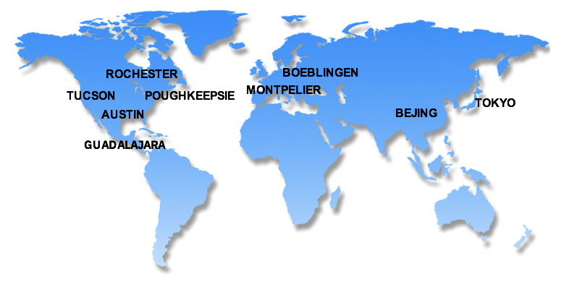
IBM Systems Worldwide Client Experience Centers
IBM Systems Worldwide Client Experience Centers maximize IBM Systems competitive advantage in the Cloud and Cognitive era by providing access to world class technical experts and infrastructure services to assist Clients with the transformation of their IT implementations..
9 Worldwide Locations (* also Infrastructure Hubs):
Austin TX , *Poughkeepsie NY, Rochester MN, Tucson AZ, *Beijing CHINA, Boeblingen GERMANY, Guadalajara MEXICO,*Montpellier FRANCE, Tokyo JAPAN
Client Experience
Tailored, in-depth technology
Innovation Exchange
Events
Relationship building
Demonstrations
Meetups
Solution workshops
Remote options
(Inbound & Outbound)
Architecture & Design
Advise clients, “Art of the Possible”
Discovery & Design Workshops, Consulting,
Showcases, Reference Architectures, Co-Creation of assets
(Inbound & Outbound)
Infrastructure
Solutions
Benchmarks, MVP & Proof of Technology
“Test Drives”
Demonstrations
Infrastructure Services
Certify ISV solutions
Hosting
Cloud Environment
(Inbound to Centers)
.
Content
Content Development
IBM Redbooks
Training Courses
Video courses
“Test Drives”
Demonstrations
NEW: Co-Creation Lab; CEC Cloud; RedHat Center of Competency
For further information, please contact the Centers via email at: ccenter@us.ibm.com
Notes:
ISCEP Link
2

Slide 3
Agenda
segmentation 101
https://forums.fast.ai/t/deep-learning-lesson-3-notes/29829/7
-- camvid dataset
-- U-Net model for Symantec Segmentation
-- Data
--Model
--Results
-- Use fastai prebuilt notebook
Notes:
(add commentary on how IBM power can accelerate usage of pytorch)

Slide 4
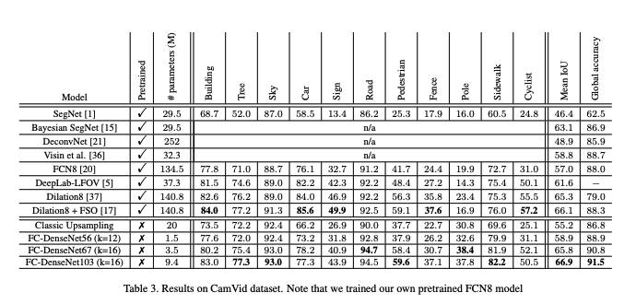
Main Idea for Fastai
Create wrappers around common operations for data and models
Implement a common learning scheme that quickly finds close to state of the art results
For image segmentation: here is the paper describing the original U-Net model for biological samples
https://arxiv.org/pdf/1611.09326.pdf
Installation via simple pip or conda:
https://docs.fast.ai/install.html
conda install -c pytorch -c fastai fastai
Our model results will generally come close to or else outperform the original authors

Slide 5
What is segmentation?
Semantic Segmentation: Parsing thru each pixel of an image and assigning that pixel to one of a finite classes
The classes are typically labelled according to identifiable objects a client cares about inside each image
Examples could include: pedestrians, sports balls, sports players, buildings, roads, or any such item that you wish to count, locate, determine extent or area
Example: Images containing bicycle crossing sign, pedestrians, buildings, sidewalks, etc
Image
Segmentation labels

Slide 6
The main idea?
Figure put a labeling scheme that is not too laborious (people have already figured out a pretty good way) to label each pixel in an image
Loop thru each pixel in an image and classify it according to the labeling scheme
Easy right?
Explanation of labeling scheme:
Allow a human editor to “paint” over an image using different colors – one for each item of interest in an image
Use the painted image as a template or mask. Each color will also be associated with a text file – sort of an index – that specifies which color is which kind of class
['Animal', 'Archway', 'Bicyclist', 'Bridge', 'Building', 'Car', 'CartLuggagePram', 'Child', 'Column_Pole', 'Fence', 'LaneMkgsDriv', 'LaneMkgsNonDriv', 'Misc_Text', 'MotorcycleScooter', 'OtherMoving', 'ParkingBlock', 'Pedestrian', 'Road', 'RoadShoulder', 'Sidewalk', 'SignSymbol', 'Sky', 'SUVPickupTruck', 'TrafficCone', 'TrafficLight', 'Train', 'Tree', 'Truck_Bus', 'Tunnel', 'VegetationMisc', 'Void', 'Wall']

Slide 7
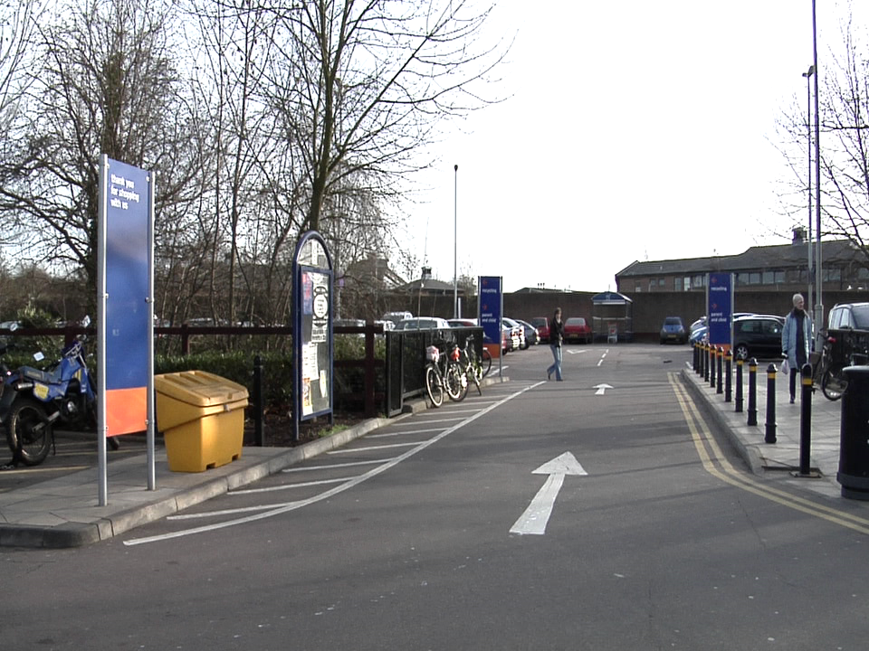
Datasets
/gpfs/home/s4s004/racheseb/.fastai/data/camvid/
PosixPath('/gpfs/home/s4s004/racheseb/.fastai/data/camvid/labels’),
PosixPath('/gpfs/home/s4s004/racheseb/.fastai/data/camvid/images’),
PosixPath('/gpfs/home/s4s004/racheseb/.fastai/data/camvid/codes.txt’),
PosixPath('/gpfs/home/s4s004/racheseb/.fastai/data/camvid/valid.txt')
Images
Labels
['Animal', 'Archway', 'Bicyclist', 'Bridge', 'Building', 'Car', 'CartLuggagePram', 'Child', 'Column_Pole', 'Fence', 'LaneMkgsDriv', 'LaneMkgsNonDriv', 'Misc_Text', 'MotorcycleScooter', 'OtherMoving', 'ParkingBlock', 'Pedestrian', 'Road', 'RoadShoulder', 'Sidewalk', 'SignSymbol', 'Sky', 'SUVPickupTruck', 'TrafficCone', 'TrafficLight', 'Train', 'Tree', 'Truck_Bus', 'Tunnel', 'VegetationMisc', 'Void', 'Wall']
Notes:
https://arxiv.org/pdf/1505.04597.pdf

Slide 8
Tools to label your own data
List is growing. Many of these tools now incorporate AI to make labeling easier
Annotorious
It’s a free, easy to use, MIT-licensed annotation tool for labeling of images on a website.
Sloth
Sloth is a versatile annotation tool for various data labeling tasks related to computer vision research.
LabelMe
LabelMe is an open source online data labeling tool. With simple signup, it allows users to label images and share their annotation publically
Lionbridge AI
offers an end-to-end data labeling and annotation platform for data scientists looking to train machine learning models.
Computer Vision Annotation Tool (CVAT)
The tool supports tasks like object detection, image segmentation and image classification
Supervise.ly
Transform images / videos / 3d point cloud into high-quality training data. Includes NN plugins to make labeling easier
Notes:
Annotorious
It’s a free, easy to use, MIT-licensed annotation tool for labeling of images on a website. It’s free for commercial use as well. Integrating it with your website only requires adding 2-3 lines of code. You can also explore many of its features in the demos.
Sloth
Sloth is a versatile annotation tool for various data labeling tasks related to computer vision research. It’s free and is one of the most popular tools for facial recognition, therefore, is widely used for surveillance and user identification related applications.
LabelMe
LabelMe is an open source online data labeling tool. With simple signup, it allows users to label images and share their annotation publically, which is primarily used for a range of computer vision based applications and research.
Lionbridge AI
Lionbridge AI offers an end-to-end data labeling and annotation platform for data scientists looking to train machine learning models. With over 20 years of hands-on experience creating custom data for the world’s largest technology companies, Lionbridge AI has built the most intuitive data annotation platform on the market.
This all-in-one platform allows you to build custom training datasets quickly and cost effectively while maintaining data quality. Furthermore, the tool works for all major file types, with unique features to handle text, audio, image & video data.
Computer Vision Annotation Tool (CVAT)
The Computer Vision Annotation Tool (CVAT) is a web-based tool for annotating digital images and videos. The tool supports tasks like object detection, image segmentation and image classification. Although the tool itself requires some time to learn and master, CVAT boasts a wide range of features for labeling computer vision data.

Slide 9
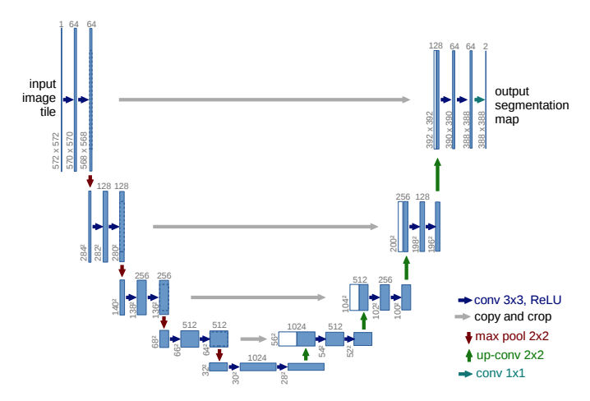
Model
Fastai example – implements the circled are w ResNet – but the underlying architecture is selectable
Model is Unet:
Makes smaller to generalize then expands to estimate which pixel is which class.
Implemented here w ResNet but other architectures can be tried out
Notes:
Valid.txt contains the image file names to hold for validation set:
0016E5_07959.png
0016E5_07961.png
0016E5_07963.png
0016E5_07965.png
…

Slide 10
Models: U-Net segmentation is different from segmentation used in PAIV
Detectron (used in PAIV )
Based on modified versions of region proposal methods culminating in Mask R-CNN
Practical implication is that for PAIV, the result is a set of polygon vertices and classes for the polygons
Each object is its own instance
Using vertices it is easy(ish) to do math computations on locations, areas, orientations of objects
Label with Polygons
U-Net (Semantic Segmentation/ Pixel classification)
Also uses Masks but the goal is to classify each pixel as belonging to one class or another
Practical implication is that result is a mask and a score indicating which class each pixel belongs to.
Each object is not its own instance – two bicycles in image will likely be assigned to the same class
So this is great for image composition – seems like location and polygon boundaries will take extra s
Steps
Label with a mask editor (pixel editor)

Slide 11
Methodology
Start w smaller resolution images
Transfer learning to start
Determine best learning rate : fit_onecycle
Goes from smaller to bigger resolution images
Unfreeze: more layers to custom fit
Use learning rate finder and heuristics to choose proper learning rates at each stage

Slide 12
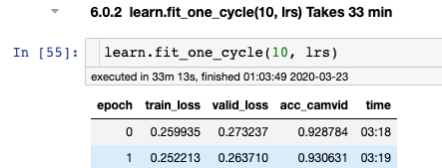
Results:
Fastai
Original Paper

